Slide 1
Why Statistics
Vinay Mahajan
Varsha Mahajan
Understand the data and its types
Usage of data
Data collection source (primary – secondary – tertiary)

Slide 2
Types of Data
Non - parametric test
Parametric test
Qualitative
Categorical / Attributes
Quantitative
Numerical
binary
nominal
ordinal
discrete
continuous
2 categories +
more categories +
order matters +
numerical +
uninterrupted
Counts
Time
Age
Height
Blood counts
Speed of a car
Income
Time to event
Dead/alive
Treatment/placebo
Disease/no disease
Exposed/Unexposed
Blood type (O, A, B, AB)
Marital status
Occupation
Staging in cancer as I,II,III or IV
Birth order—1st, 2nd, 3rd, etc.
Letter grades (A, B, C, D, F)
Ratings on a scale from 1-5
Age in categories (10-20, 20-30, etc.)
Display data, calculate frequency
Calculate frequency, average, variability → Parameters

Slide 3
Data Collection - Types
Primary data –
First hand information
Collected with a purpose
Unadulterated
Reliable, authentic and objective
Can be further used for analysis and published
Methods of collection –
Personal investigation or via investigators (clinical trials)
Sample surveys (questionnaires) or telephonic investigation

Slide 4
Data Collection - Types
Secondary data –
Second hand information
Not original, was collected with a different purpose
Need to believe in the authenticity
Some analysis or summary already done
Already published
Methods of collection –
Literature review
Data published in journals and newspaper
Official / government database (e.g. census )
Internet articles

Slide 5


Slide 6
Assignment
Find the different methods of primary and secondary data collection.
Save these with the following name “Day_2_assignment1_yourname.doc”

Slide 7
Summary Measures: Overview
Describing Data Numerically
Center and Location
Other Measures of Location
Variation
Range
Mean
Percentiles
Median
Interquartile Range
Quartiles
Mode
Variance
Weighted Mean
Standard Deviation

Slide 8
1. Measures of Central Tendency

Slide 9
1.1. Mean (Arithmetic Mean)
Mean (arithmetic mean) of data values
Sample mean
Population mean
Sample Size
Population Size

Slide 10
1.1 Mean (Weighted Mean)
Used when values are grouped by frequency or relative importance

Slide 11
1.2. Mode
A measure of central tendency
Value that occurs most often
Not affected by extreme values
Used for either numerical or categorical data
There may be no mode or several modes
Mode = 9
No Mode
0 1 2 3 4 5 6
0 1 2 3 4 5 6 7 8 9 10 11 12 13 14

Slide 12
1.3. Median
Robust measure of central tendency
Not affected by extreme values
In an ordered array, the median is the “middle” number
If n or N is odd, the median is the middle number
If n or N is even, the median is the average of the two middle numbers
0 1 2 3 4 5 6 7 8 9 10
0 1 2 3 4 5 6 7 8 9 10 12 14
Median = 5
Median = 5

Slide 13
1.4. Shape of a Distribution
Describes how data is distributed
Symmetric or skewed
Notes:
When you have a symmetrical distribution for continuous data, the mean, median, and mode are equal. In this case, analysts tend to use the mean because it includes all of the data in the calculations. However, if you have a skewed distribution, the median is often the best measure of central tendency.
When you have ordinal data, the median or mode is usually the best choice. For categorical data, you have to use the mode.

Slide 14
2. Other Location Measures

Slide 15
2.1. Quartiles
Split Ordered Data into 4 Quarters
Position of ith Quartile
25%
25%
25%
25%

Slide 16
2.1. Quartiles (continued)
Data in Ordered Array: 11 12 13 16 16 17 17 18 21
= Median = 16
Q3
= 17,5

Slide 17
2.2. Box-and-Whisker Plot
Graphical Display of Data Using 5-Number Summary:
X
Q
Median
Q
X
smallest
1
3
largest
4
6
8
10
12

Slide 18
2.3. Distribution Shape and Box-and-Whisker Plot
Left-Skewed
Symmetric
Right-Skewed

Slide 19
3. Measures of Variation
Variation
Variance
Standard Deviation
Coefficient of Variation
Range
Population
Variance
Population
Standard
Deviation
Sample
Variance
Sample
Standard
Deviation
Interquartile Range

Slide 20
3.1. Range
Measure of variation
Difference between the largest and the smallest observations:
Ignore the way in which data are distributed
Range = 12 - 7 = 5
Range = 12 - 7 = 5
7 8 9 10 11 12
7 8 9 10 11 12

Slide 21
3.2. Interquartile Range
Interquartile range = 3rd quartile – 1st quartile
Data in Ordered Array: 11 12 13 16 16 17 17 18 21

Slide 22
3.3. Variance
Important measure of variation
Shows variation about the mean
Sample variance:
Population variance:

Slide 23
3.4. Standard Deviation
Most important measure of variation
Shows variation about the mean
Sample standard deviation:
Population standard deviation:

Slide 24
Comparing Standard Deviations

Slide 25
3.5. Coefficient of Variation
Measure of Relative Dispersion
Always in %
Shows Variation Relative to Mean
Used to Compare 2 or More Groups
Formula:
Population Sample

Slide 26
The Correlation
Correlation measures the strength/ predictability of a relationship between two variables.

Slide 27
Interpreting Covariance
cov(X,Y) > 0 X and Y are positively correlated
cov(X,Y) < 0 X and Y are inversely correlated
cov(X,Y) = 0 X and Y are independent
Pearson’s Correlation Coefficient is standardized covariance (unitless):

Slide 28
Correlation
Unit-less
Ranges between –1 and 1
The closer to –1, the stronger the negative linear relationship
The closer to 1, the stronger the positive linear relationship
The closer to 0, the weaker any positive linear relationship
The two variables are treated as equals r_{xy} = r_{yx}

Slide 29
Scatter Plots of Data with Various Correlation coefficients
Y
Y
Y
X
X
X
r = -1
r = -.6
r = 0
Y
Y
Y
X
X
X
r = +1
r = +.3
r = 0
Slide from: Statistics for Managers Using Microsoft® Excel 4th Edition, 2004 Prentice-Hall

Slide 30
Linear Correlation
Linear relationships
Curvilinear relationships
Y
Y
X
X
Y
Y
X
X
Slide from: Statistics for Managers Using Microsoft® Excel 4th Edition, 2004 Prentice-Hall

Slide 31
Linear Correlation
Strong relationships
Weak relationships
Y
Y
X
X
Y
Y
X
X
Slide from: Statistics for Managers Using Microsoft® Excel 4th Edition, 2004 Prentice-Hall

Slide 32
Linear Correlation
No relationship
Y
X
Y
X
Slide from: Statistics for Managers Using Microsoft® Excel 4th Edition, 2004 Prentice-Hall

Slide 33
The Correlation
Anscombe's Quartet: to demonstrate both the importance of graphing data before analyzing it
and the effect of outliers on statistical properties.
 | I |  | II |  | III |  | IV
 | x | y | x | y | x | y | x | y
 | 10 | 8.04 | 10 | 9.14 | 10 | 7.46 | 8 | 6.58
 | 8 | 6.95 | 8 | 8.14 | 8 | 6.77 | 8 | 5.76
 | 13 | 7.58 | 13 | 8.74 | 13 | 12.74 | 8 | 7.71
 | 9 | 8.81 | 9 | 8.77 | 9 | 7.11 | 8 | 8.84
 | 11 | 8.33 | 11 | 9.26 | 11 | 7.81 | 8 | 8.47
 | 14 | 9.96 | 14 | 8.1 | 14 | 8.84 | 8 | 7.04
 | 6 | 7.24 | 6 | 6.13 | 6 | 6.08 | 8 | 5.25
 | 4 | 4.26 | 4 | 3.1 | 4 | 5.39 | 19 | 12.5
 | 12 | 10.84 | 12 | 9.13 | 12 | 8.15 | 8 | 5.56
 | 7 | 4.82 | 7 | 7.26 | 7 | 6.42 | 8 | 7.91
 | 5 | 5.68 | 5 | 4.74 | 5 | 5.73 | 8 | 6.89
 | I | II | III | IV
Mean | 9 | 7.5 | 9 | 7.5 | 9 | 7.5 | 9 | 7.5
Var | 11 | 4.12 | 11 | 4.12 | 11 | 4.12 | 11 | 4.12
Cor | 0.816 |  | 0.816 |  | 0.816 |  | 0.816
Linear regression line in each case : y = 3 + 0.5x

Slide 34
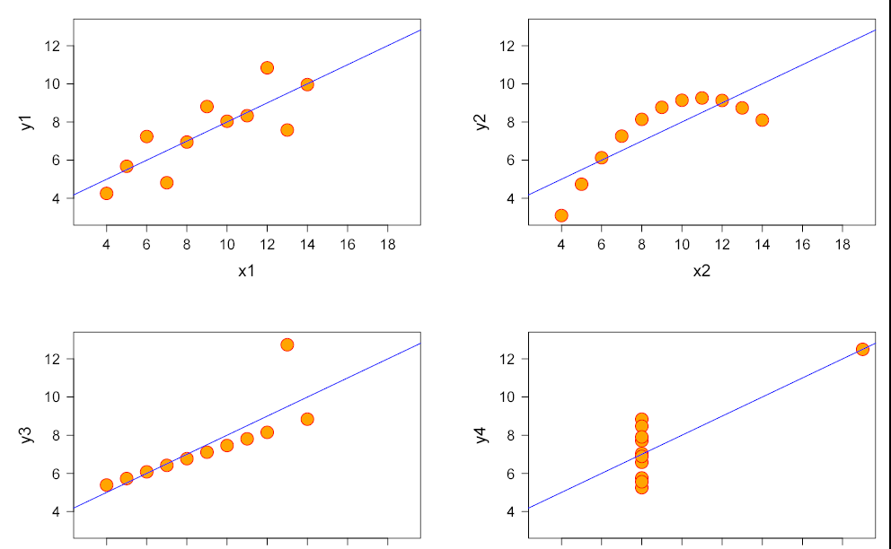
The Correlation
Anscombe's Quartet: to demonstrate both the importance of graphing data before analyzing it
and the effect of outliers on statistical properties.
Normally distributed | Not distributed normally; while an obvious relationship between the two variables can be observed, it is not linear, and the Pearson correlation coefficient is not relevant
The distribution is linear, but with a different regression line, which is offset by the one outlier which exerts enough influence to alter the regression line and lower the correlation coefficient from 1 to 0.81 | One outlier is enough to produce a high correlation coefficient, even though the relationship between the two variables is not linear.

Slide 36
Assignment
Data I |  | Data II |  | Data III |  | Data IV
x | y | x | y | x | y | x | y
10 | 8.04 | 10 | 9.14 | 10 | 7.46 | 8 | 6.58
8 | 6.95 | 8 | 8.14 | 8 | 6.77 | 8 | 5.76
13 | 7.58 | 13 | 8.74 | 13 | 12.74 | 8 | 7.71
9 | 8.81 | 9 | 8.77 | 9 | 7.11 | 8 | 8.84
11 | 8.33 | 11 | 9.26 | 11 | 7.81 | 8 | 8.47
14 | 9.96 | 14 | 8.1 | 14 | 8.84 | 8 | 7.04
6 | 7.24 | 6 | 6.13 | 6 | 6.08 | 8 | 5.25
4 | 4.26 | 4 | 3.1 | 4 | 5.39 | 19 | 12.5
12 | 10.84 | 12 | 9.13 | 12 | 8.15 | 8 | 5.56
7 | 4.82 | 7 | 7.26 | 7 | 6.42 | 8 | 7.91
5 | 5.68 | 5 | 4.74 | 5 | 5.73 | 8 | 6.89

Slide 37
How to submit?
Find the mean, variance, correlation and coefficient of variance for the 4 data sets and write your interpretation
Plot these data points X and Y and summarize your observation
Save these with the following name “Day_2_assignment2_yourname.doc”

